Slide 1
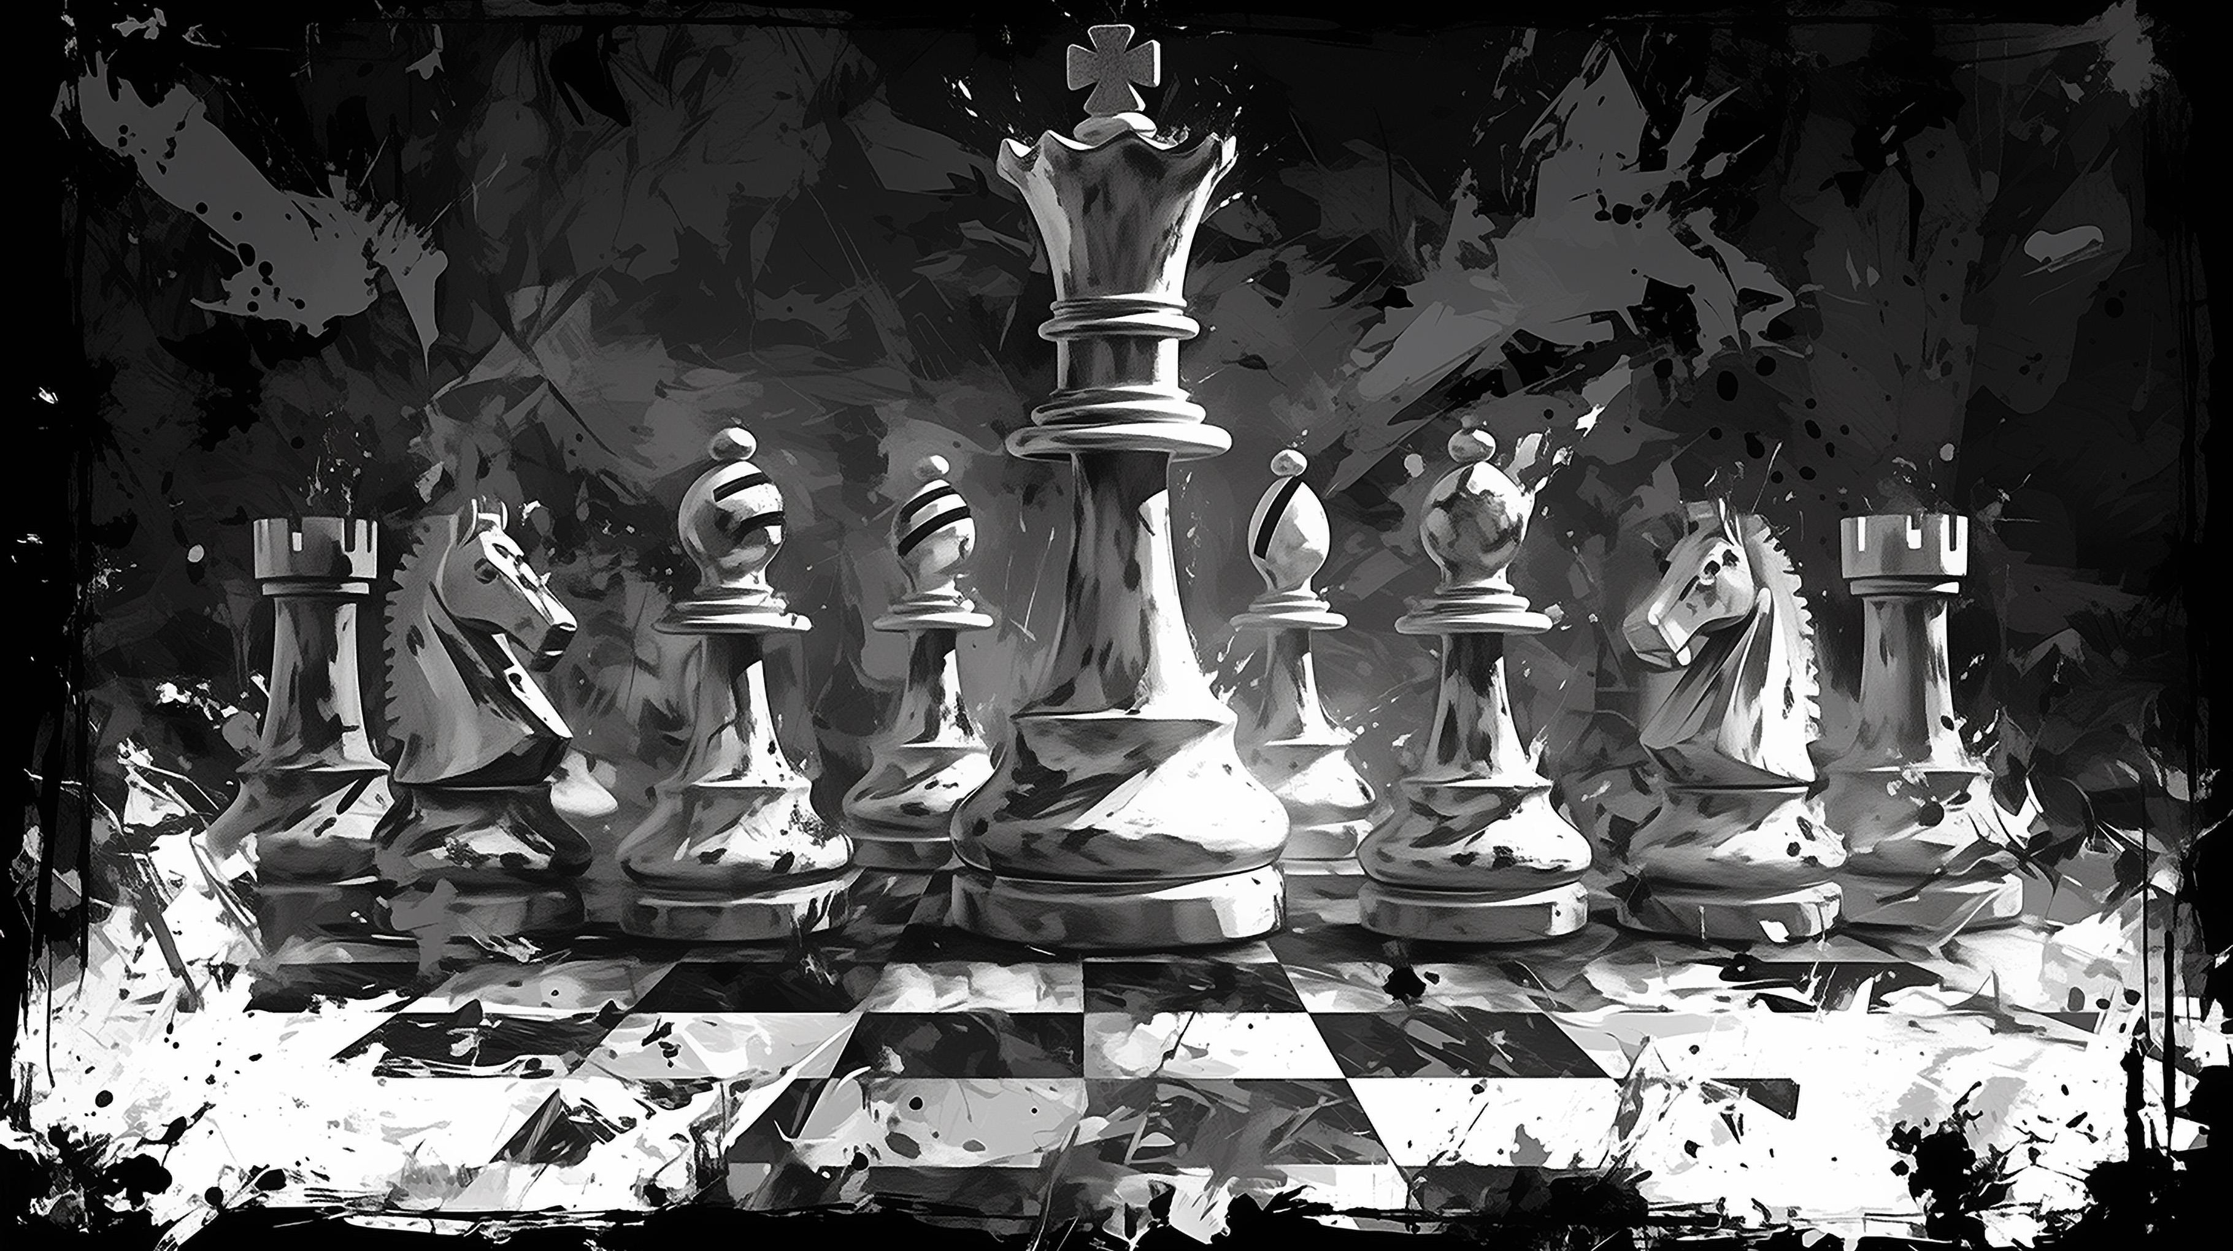
Tensor-Chess: Building a Chess Game with TensorFlow
From Piece Movement to Special Rules: A Deep Dive into Tensor-Based Chess Simulation
Presented by: Duan Shujie (AIT2209069)
Keven Lee Zhang Yan (AIT2504281)
Siam Nur Ahmed (AIT2504516)
Liang Fang Wang (IBU2402211)
Tan Tai Ren (AIT2502092)

Slide 2
Division of work
Siam Nur Ahmed (AIT2504516)：Responsible for introducing the overall architecture and the use of tensorflow
Keven Lee Zhang Yan (AIT2504281)：Responsible for introducing the construction of the chessboard special transposition, and the main function
Duan Shujie (AIT2209069)：Responsible for introducing the main parts of the code: including unity function, move function, score function
Liang Fang Wang (IBU2402211)：Responsible for showing and explaining the demo part

Slide 3
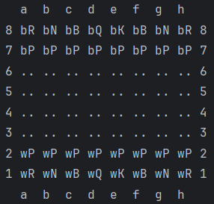
What is Tensor-Chess and Why it Matters?
It is a simplified, CLI-based chess game built using TensorFlow.
The game uses tensors to represent and update the board dynamically.
It makes TensorFlow approachable for beginners through a creative game.
It introduces to:
Data structures (8 x 8 tensors)
Rule-based decision logic
Turn-based gameplay design
Provides a hands-on learning experience in TensorFlow, logic design, and command-line UX.
SIAM NUR AHMED (AIT2504516)

Slide 4
Why TensorFlow for Chess?
Python lists are great for static structures but lack built-in support for:
Gradient updates
Variable tracking
Model integration
Numpy arrays are efficient, but not designed for training ready or graph-based operations.
TensorFlow is better to use for dynamic variable control (tf.Variable for mutable game state).
TensorFlow supports:
Slicing
Logical masking
Broadcasting
Features | Python List | Numpy Array | TensorFlow
Mutable Grid Logic | ✅ | ✅ | ✅
AI Integration Ready | ❌ | ⚠️ | ✅
GPU Acceleration | ❌ | ⚠️ | ✅
Used for ML Models | ❌ | ⚠️ | ✅
✅= Ideal ⚠️=Not proper ❌= Not suitable
SIAM NUR AHMED (AIT2504516)

Slide 5
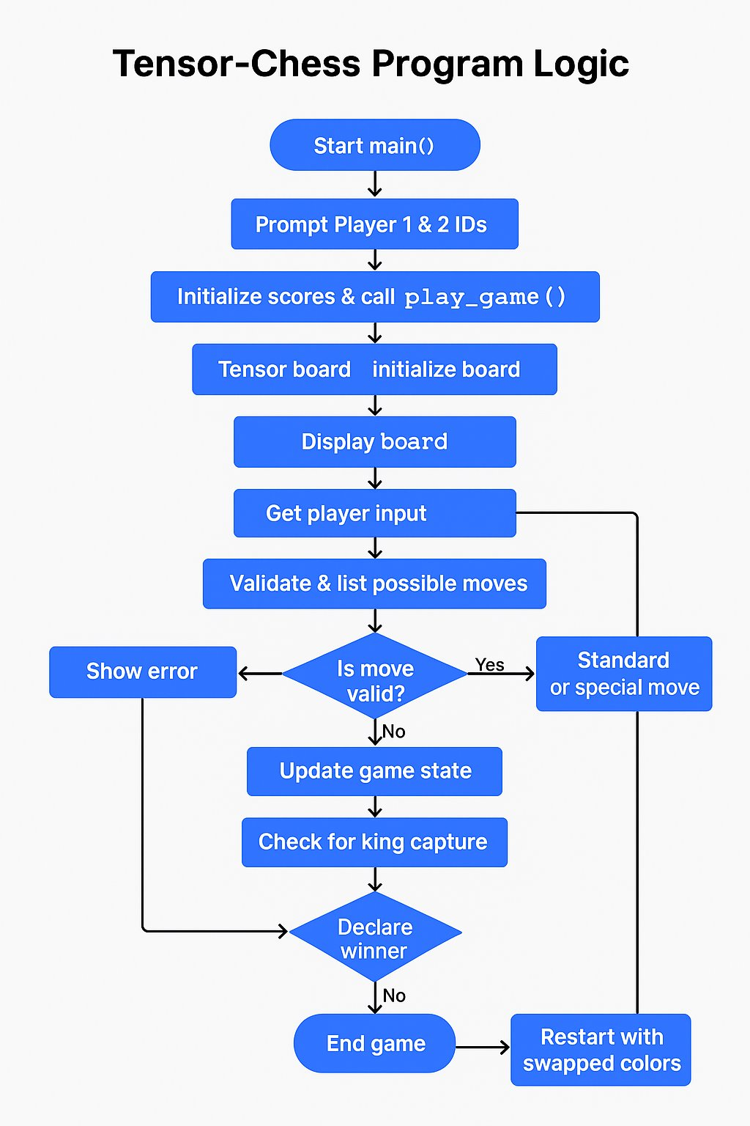
How Tensor-Chess Works
The game is played entirely through the Command Line Interface (CLI).
Each player takes turns making moves in algebraic notation (e.g., e2 to e4).
TensorFlow tracks and updates piece positions after every move.
Special moves like castling, en passant, and promotion are automatically detected and processed.
The score is updated based on the type of captured piece and move type.
The game continues until one player’s king is captured.
SIAM NUR AHMED (AIT2504516)

Slide 6
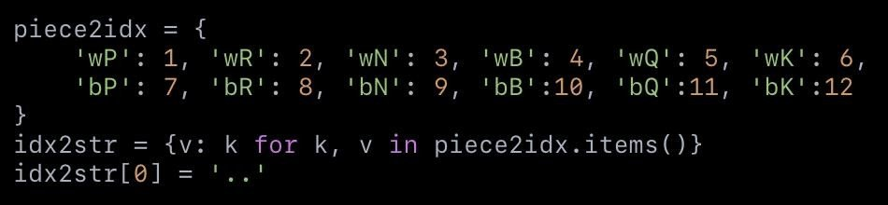
Piece Encoding
Each chess piece is represented as a unique integer.
Encoding are stored in two dictionaries:
piece2idx: maps piece names → integers (e.g., 'wP' → 1)
idx2str: maps integers → piece strings
0 is reserved for empty squares.
Enables easy manipulation of the TensorFlow 8×8 board tensor.
Simplifies:
Move validation
Piece comparisons
Scoring logic
Piece | Code
wP (White Pawn) | 1
wR (White Rook) | 2
wK (White King) | 6
bP (Black Pawn) | 7
bR (Black Rook) | 8
bK (Black King) | 12
Empty | 0
KEVEN LEE ZHANG YAN (AIT2504281)

Slide 7
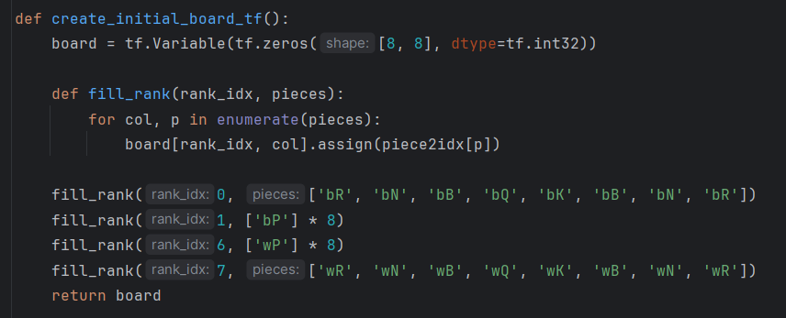
Building the Chessboard
The chessboard is represented as an 8×8 TensorFlow tf.Variable matrix.
Each cell holds an integer indicating the piece (or 0 for empty).
create_initial_board_tf() initializes the board with:
Black pieces on ranks 1–2 (top)
White pieces on ranks 7–8 (bottom)
Uses fill_rank() helper to assign pieces row by row.
KEVEN LEE ZHANG YAN (AIT2504281)

Slide 8
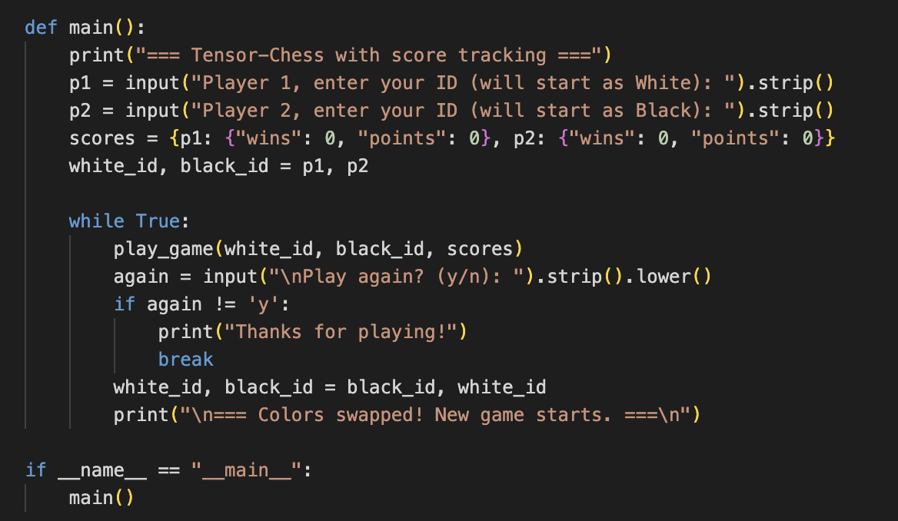
The main() Function
Acts as the starting point of the program.
Initializes player IDs, score system and controls the game loop.
Handles color - swapping and replay options.
Keeps score across matches, not just within the game.
KEVEN LEE ZHANG YAN (AIT2504281)
DUAN SHUJIE(AIT2209069)

Slide 9
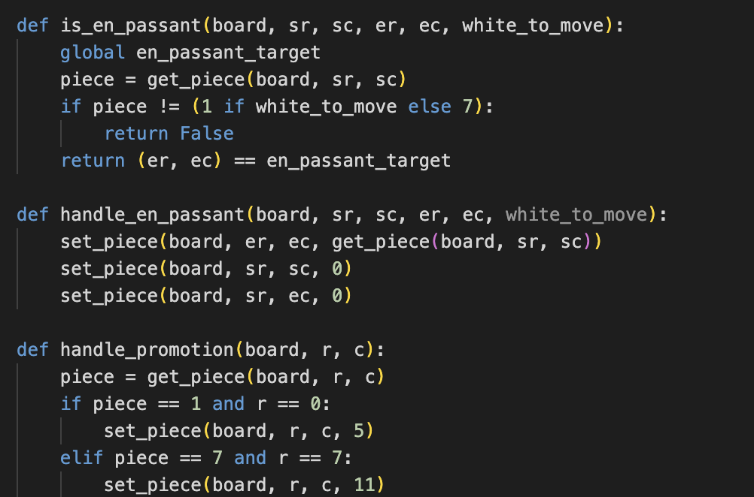
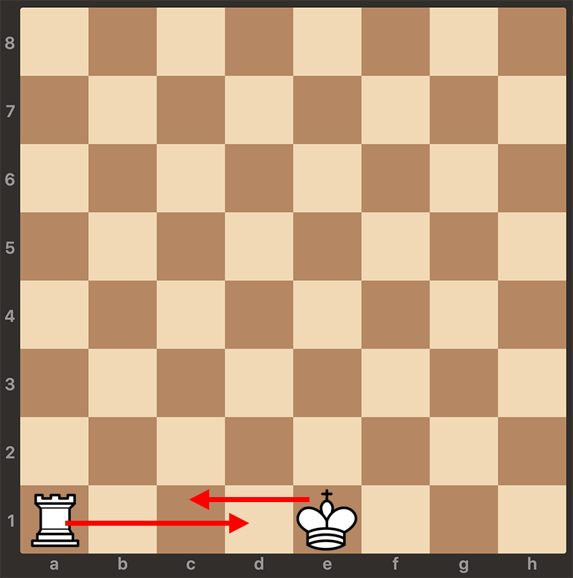
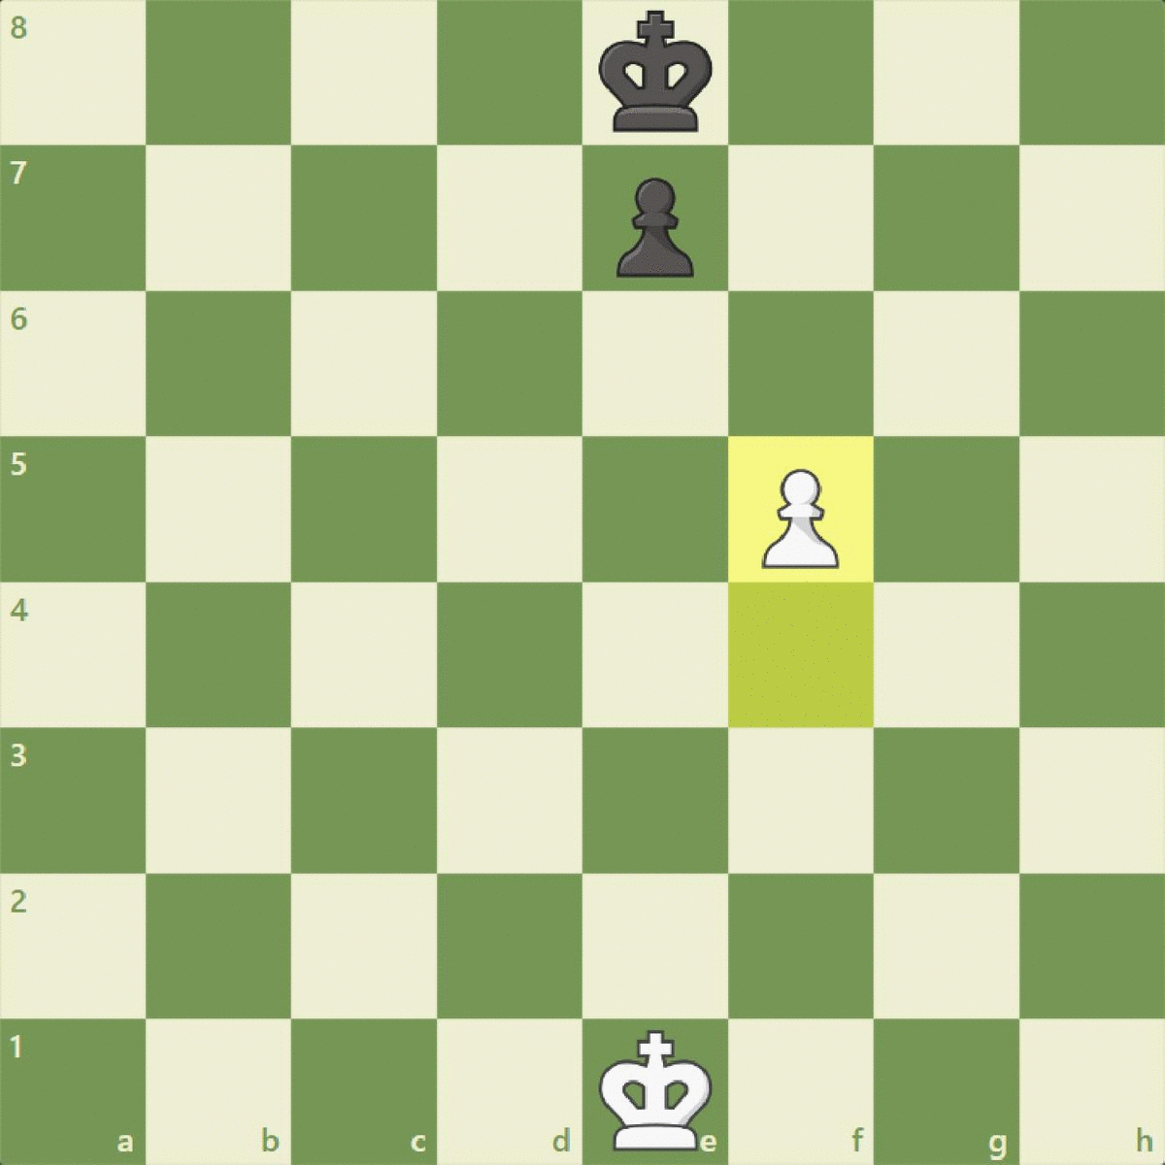
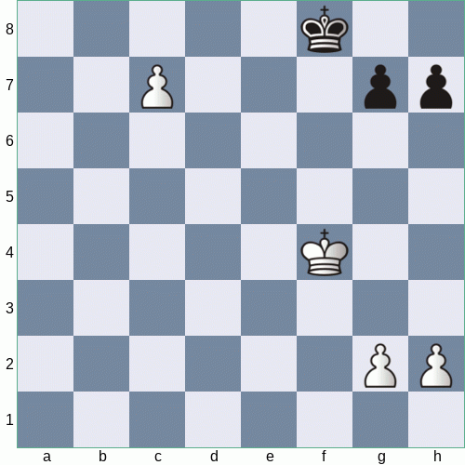
Special Moves
Castling:
King and rook move together if path is clear and neither has moved.
En Passant:
Allows pawn to capture an adjacent pawn that just moved two squares.
Pawn Promotion:
Pawn reaching the end rank is auto-promoted to a queen
Conditions are tracked using global flags. This keyword also ensures consistent state during move validation and rule enforcement.
Points are awarded for successful execution of these moves.
Castling
En Passant
Promotion
KEVEN LEE ZHANG YAN (AIT2504281)

Slide 10
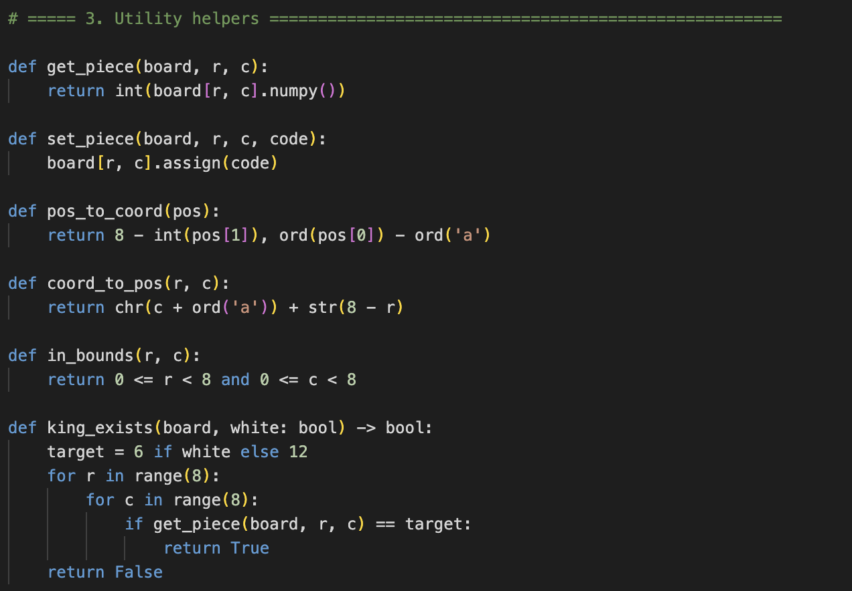
Utility Function
Utility functions simplify board operations:
get_piece() / set_piece(): access or modify board cells
pos_to_coord() / coord_to_pos(): convert between 'e2' and (6,4)
in_bounds(): ensures positions stay within the 8×8 board
king_exists(): used to detect checkmate condition
These functions are reused across move generation, validation and gameplay
DUAN SHUJIE(AIT2209069)

Slide 11
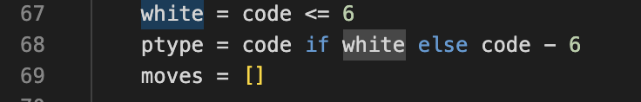
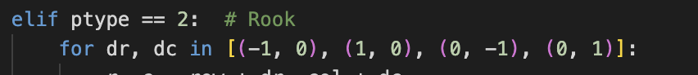
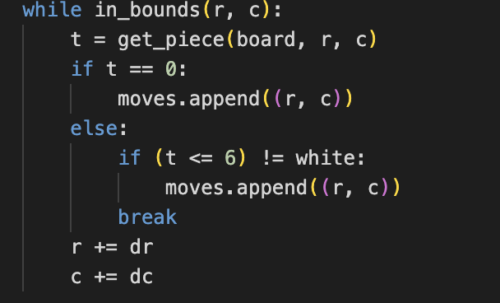
Move Generation
Determine which side the chess piece belongs to (white 1~6, black 7~12).
Determine the chess piece type by code-6, removing the color effect.
Use ptype to use the if-elif loop to determine the type of chess piece.
Use a for loop to record the direction the piece can go to, which serves as the starting point for the next while loop.
If the grid is empty, you can move to this position and add moves.
Otherwise, it means there is a chess piece on the grid. If the piece on the square is not ours, we can capture it and add moves.
Continue exploring the next cell in direction (dr, dc).
DUAN SHUJIE(AIT2209069)

Slide 12
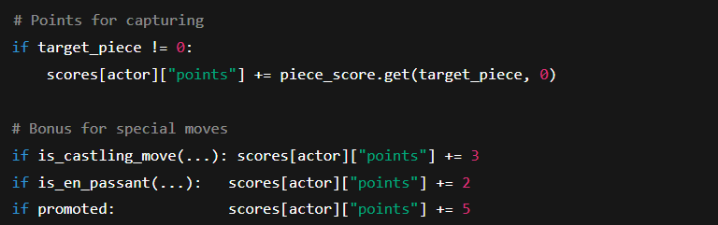
Score Tracking & Game Progress
Each player is tracked using a unique player ID.
Scores are stored in a dictionary for persistent tracking.
The game automatically updates scores after:
Piece capture
Special moves
Winning via checkmate
Point System Breakdown
Action | Points Earned
Capturing a Pawn | +1
Capturing a Rook | +3
Capturing a Bishop | +5
Capturing a Queen | +9
Castling | +3
En Passant | +2
Pawn Promotion | +5
Checkmate Win | +10
DUAN SHUJIE(AIT2209069)

Slide 13
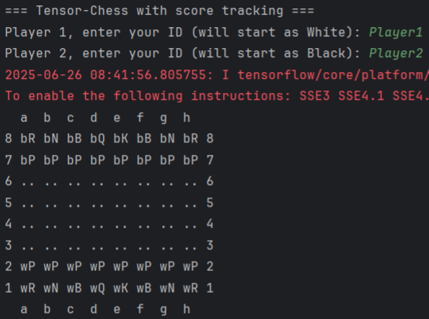
Demo I
The program is coded in python, and the program name is called "main.py".
When the program started, it will prompt for 'Player 1' name, which is the 'White Player', and name of 'Player 2', which is the 'Black Player'.
LIANG FANG WANG (IBU2402211)

Slide 14
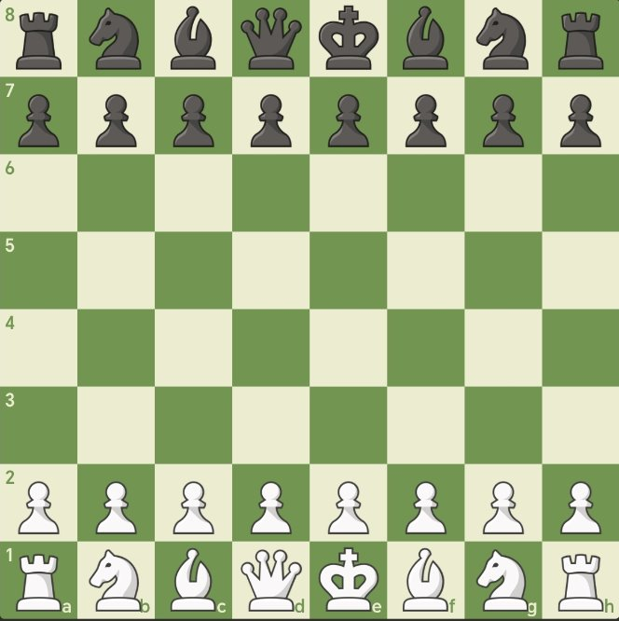
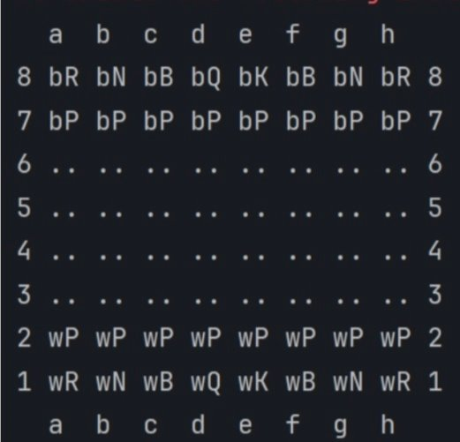
Demo II
After both players' name are captured, the program generates a checkerboard, where the 'Black player' is on top and the 'White Player' is at the bottom of the checkerboard.
'b' denote the "Black Player", and 'w' denote the "White Player".
Row is indicated by number 1 to 8, and column is indicated by a to h.
Player2 (Black)
Player1 (White)
LIANG FANG WANG (IBU2402211)

Slide 15
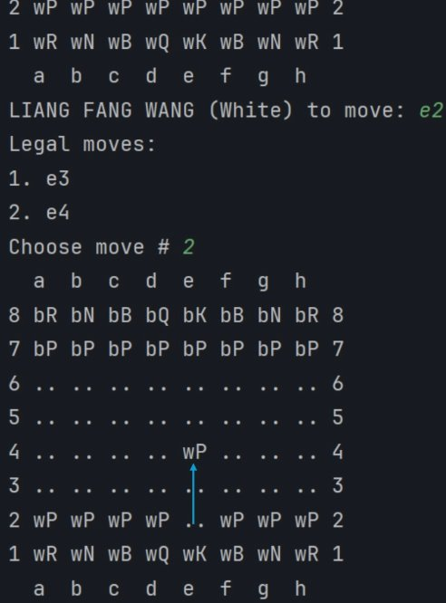
Demo III
The program will then prompt for White Player movement. To select the one to move, the combination of column and row reference will need to be provided.
In the demo example, White Player keys in "e2",it means the White Player wants to move the pawn as shown in the red circle.
Once the piece is selected, the program will prompt the player with the legal move available.
With reference to the example on the left, the valid moves are e3 and e4.
User will need to select the valid steps to proceed. As per the picture, The target position is e4.
LIANG FANG WANG (IBU2402211)

Slide 16
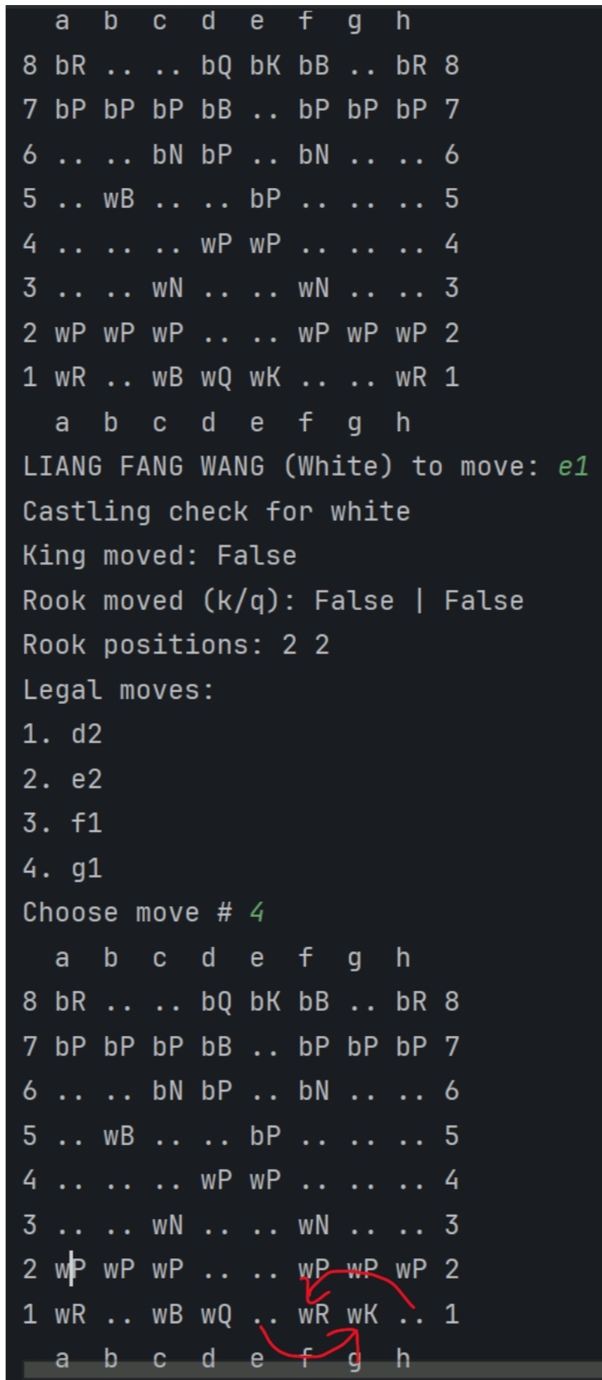
Demo IV
Under the situation there is no opponent piece in front, the program will need to cater for rook movement as well.
The programs must also control the valid movement by piece type. It generates different set of valid movement.
LIANG FANG WANG (IBU2402211)

Slide 17
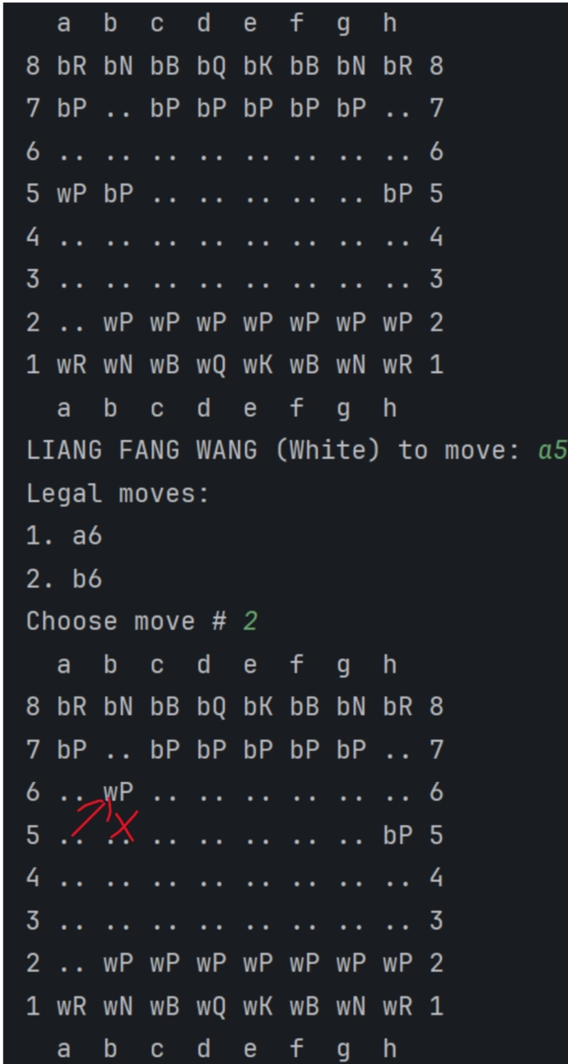
Demo V
The program needs to control the valid movement for each piece. Like in this case when the pawn move beyond 2 steps, the rules will allow the player to move the piece forward to move the adjacent position, in this case could be b6.
But we also need to control the valid move when there is nothing in front. i.e. the side way movement (i.e. horizontal left and right movement) are not allowed.
LIANG FANG WANG (IBU2402211)

Slide 18
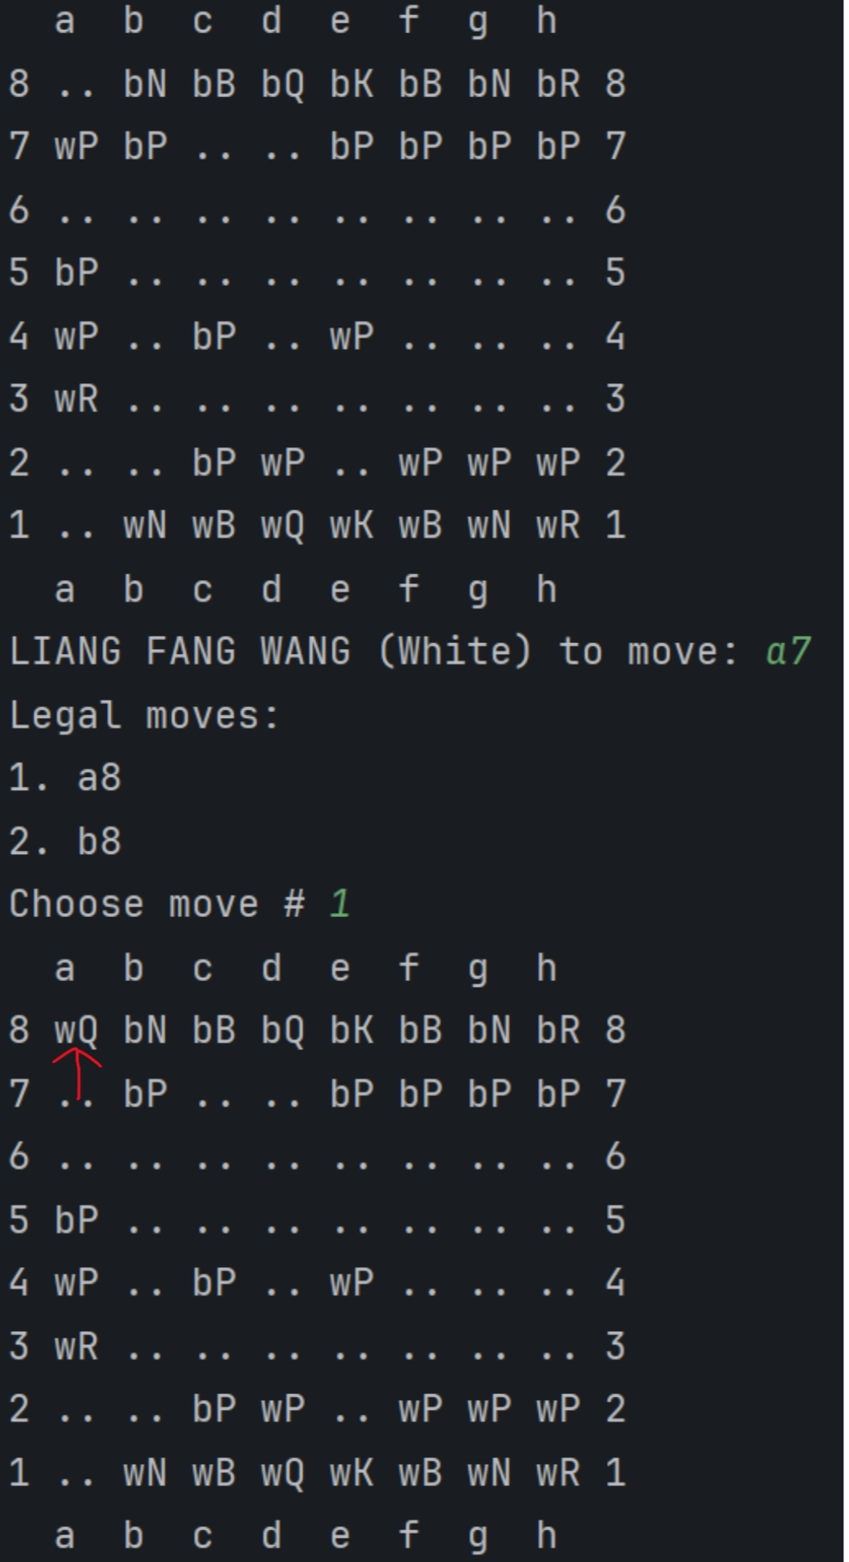
Demo VI
The program will cater of the rule where a pawn reaching the bottom of the opponent, pawn can change type into queen.
The program will switch from pawn to queen.
Which is from wP change to wQ.
LIANG FANG WANG (IBU2402211)

Slide 19
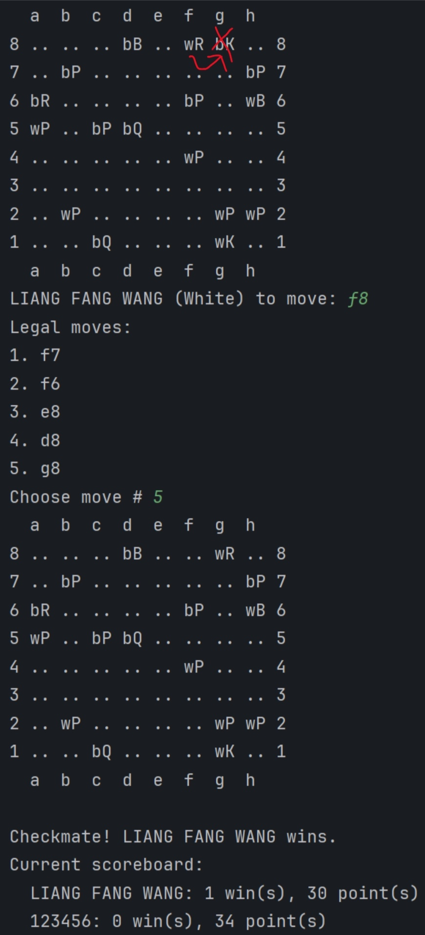
Demo VII
The program will have to understand the end game situation, that is any pieces can checkmate the opponent’s King. But in this example, the rook is next to the King, the White Rook checkmates bK (black King).
Finally, the White Rook takes over Black King.
Based on the rules defined, the program will determine the winner.
LIANG FANG WANG (IBU2402211)

Slide 20
Future enhancements:
Add AI opponent using tensorflow
GUI interface (Tkinter/PyGame)
Check/checkmate detection
Undo/replay and save/load options
Build an AI chess-bot
Conclusion & What's Next
What we achieved:
Built a functional chess CLI using python and tensorflow.
Supported all movement logic and special rules(castling, en passant, pawn promotion).
Added scoring, player IDs and turn-based replay system.
What we learned:​
Logic design, modular coding and tensorflow variable manipulation
Handling special rules and dynamic state update
Game loop structure and CLI interaction
KEVEN LEE ZHANG YAN (AIT2504281)

Slide 21
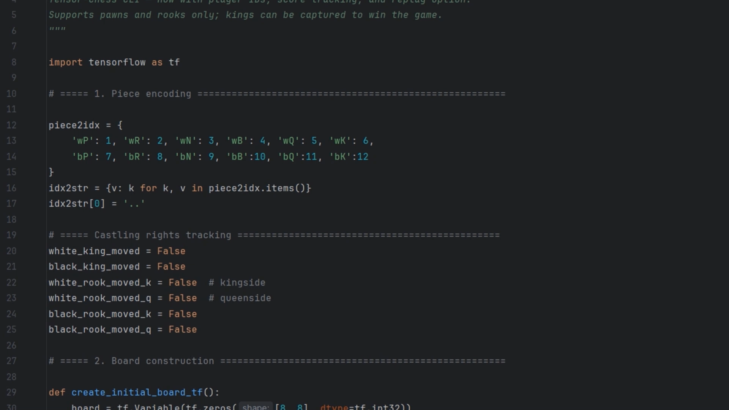

THANK YOU

